Slide 1
Four levels of listening
Paying attention to address complex challenges
Elisabetta Marinelli PhD
Elisabetta.Marinelli@pr-i.eu
www.pr-i.eu

Slide 2
The importance of listening
Notes:
Since the beginning of time listening has been celebrate in arts, music, theatre and what have you!
A good measure of the importance of listening is the number of “songs that have “listen” in the lyrics” and there were “2382 pages”
Clearly if this is such a bit topic, we shouldn’t shy away from it.
Aim:
They invite participants to have awareness about listening.
Maybe we don’t need a new thing, but a new way of listening.
AWARENESS!
Link to complex problem. We don’t have all the concepts or the knowledge. The situation is too complex.

Slide 3
Current popular knowledge on listening
What to listen to:
Your hearth
Your soul
The rain
The sea
The consequences of not listening:
Despair
Anger
Solitude
Broken relationships
Regret
Notes:
Now it’s time to talk about listening in transnational learning events!
The problem is that these songs are very clear about to whom/ what to listen:
The rain
Your hearth
Your soul
Me
You
The also spell out clearly, the consequences for not listening:
Despair
Loss of romance
Confrontantion
There is a clear sense that if done right, listening will provide wisdom!
However, in the popular discussion there is limited information about “how to listen” you are left with a sense that you are automatically capable of listening.
In the next 10 minutes, I would like challenge this automaticity and talk about learning to listen in different ways.

Slide 4
ALARM!
You have to listen to yourself but…
…face pretty harsh consequence for not listening to someone else.
Project that to global challenges and realise that…
We need better guidance on HOW to listen!

Slide 5
Level 1 – Download
Listen from your habits
Judgement
Confirmation of old opinions/
Rules re-enaction
Notes:
Imagine a circle representing the totality of what we know.
We listen from a circle at the centre of that “prison”. You are listening to what you already know. To the monkey in your head.
Those of you who have attended a meditation class have heard about the monkey in our head, which basically never stops talking and invades every part of your life. It also determines how you listed.
You are largely paying attention to your mind.

Slide 6
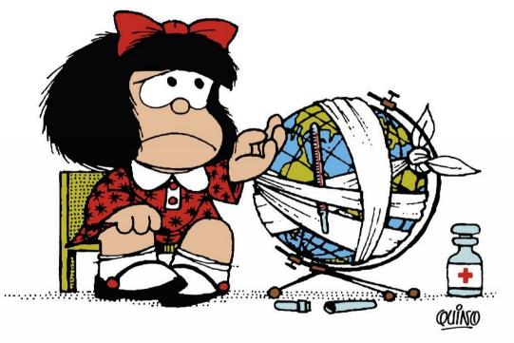
Level 2 – Factual
Listen from outside
With an open mind
Identification of discordant data
Debate
Notes:
We notice differences
We access with open mind
We notice new data we reflect on this new data.
This type of listening is very much the one we honed in our education systems. Rational, algorithmic, etc.
However, this type of listening/thinking is what led us to this complex situation and it is not enough to move us forward.
For complex social/change processes this is not enough. There are two more level that need conscious development.
Matter of factness
You expect to grow, but you don’t expect nourishment of your soul!

Slide 7
Level 3 – Empathetic listening
Listen from within
With an open hearth
Seeing through other peoples’ eyes
Dialogue and connection
Notes:
Here the focus is on the development of the individual you are listening to.

Slide 8
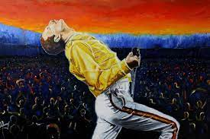
Level 4 – Generative listening
Listen from the source
With an open will
Connecting to an emerging future
Collective creativity
Notes:
The four level is generative listening
Think of Freddie mercury at Live at Wembley, and what he created with the public.
One Million people singing in unision without no warking.

Slide 9
Summary and implications for action
Global Action
Hierarchy/Planning
Market/Competition
Dialogue/Adjustment
Co-Creation
I in me
I in it
I in you
I in us

Slide 10
The importance of listening in complex problems
State of the art
Multitude of actors
Common framework
Commitment to sustainability
Desire to be proactive
To do list
Are going to the same place?
Do we understand how our views and challenges overlap?
Can we place ourselves and each other on a common map?
Are we being transformative?
Listening needed

Slide 11
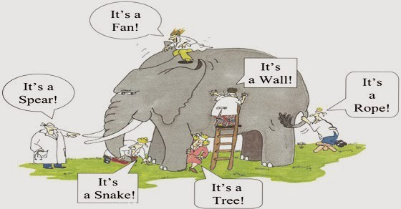
The importance of listening when facing common challenges
To sum up…
Notes:
What is happening here?
These people have never seen an elephant

Slide 12
Now what?
Reflect on which type of listening do you normally engage in when working?
What did you get out of it?
Do you think different types of listening are important when addressing societal challenges?

Slide 13
Resources
https://www.youtube.com/watch?v=eLfXpRkVZaI
https://www.collaboratiohelvetica.ch/en/blog/2020/1/15/4-levels-of-listening-theory-u-deep-listening-exercise
(Thanks Adriana for the support!)

